Slide 1
Flyweight Design Pattern
Shiau-Kang Wang

Slide 2
What is flyweight fesign pattern
Flyweight pattern is used when there is a need to create a large of number of similar objects
Since every object consumes memory space that can be crucial for low memory devices, flyweight design pattern can be applied to reduce the memory usage by sharing objects that are similar in some way rather than creating new ones.
Notes:
Flyweight design pattern is a Structural design pattern
Flyweight design pattern is used when we need to create a lot of Objects of a class. Since every object consumes memory space that can be crucial for low memory devices, such as mobile devices or embedded systems, flyweight design pattern can be applied to reduce the load on memory by sharing objects.
Before we apply flyweight design pattern, we need to consider following factors:
1. The number of Objects to be created by application should be huge.
2. The object creation is heavy on memory and it can be time consuming too.
3. The object properties can be divided into intrinsic and extrinsic properties, extrinsic properties of an Object should be defined by the client program.

Slide 3
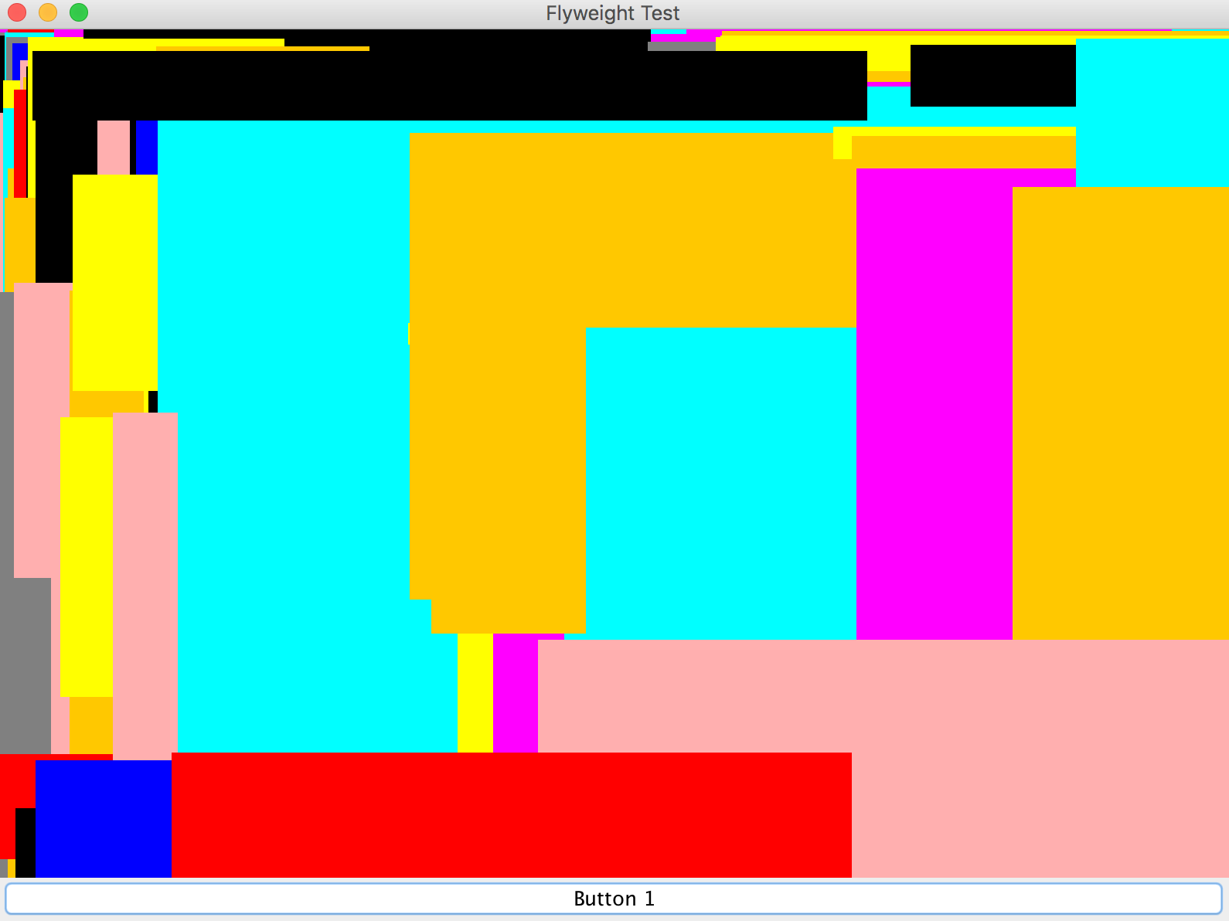
How to apply flyweight design pattern
To apply flyweight pattern, we need to divide Object property into intrinsic and extrinsic states.
Intrinsic state is stored in the flyweight; it consists of information that's independent of the flyweight's context, thereby making it sharable.
Extrinsic state depends on and varies with the flyweight's context and therefore can't be shared.
Example:
Intrinsic(color) Extrinsic(size)

Slide 4
public abstract class Shape { abstract void draw(Graphics g); }
public class Rect extends Shape {
MyRect(Color color, int upperX, int upperY, int lowerX, int lowerY) {
this.color = color;
this.x = upperX; this.y = upperY;
this.x2 = lowerX; this.y2 = lowerY;
}
public void draw(Graphics g) {
g.setColor(color);
g.fillRect(x, y, x2, y2);
}
}
public static void main(String[] args){
Graphics g = drawingPanel.getGraphics();
for(int i=0; i < 100000; ++i) {
Rect rect = new Rect(getRandColor(), getRandX(), getRandY(), getRandX(), getRandY());
rect.draw(g);
}
}
Color[] shapeColor = {Color.orange, Color.red, Color.yellow, Color.blue, Color.pink, Color.cyan, Color.magenta, Color.black};
private int getRandX(){ return (int)(Math.random()*windowWidth); }
private int getRandY(){ return (int)(Math.random()*windowHeight); }
private Color getRandColor(){
Random randomGenerator = new Random();
int randInt = randomGenerator.nextInt(9); return shapeColor[randInt]; }
Example
If we don’t use flyweight
Keep creating new instance

Slide 5
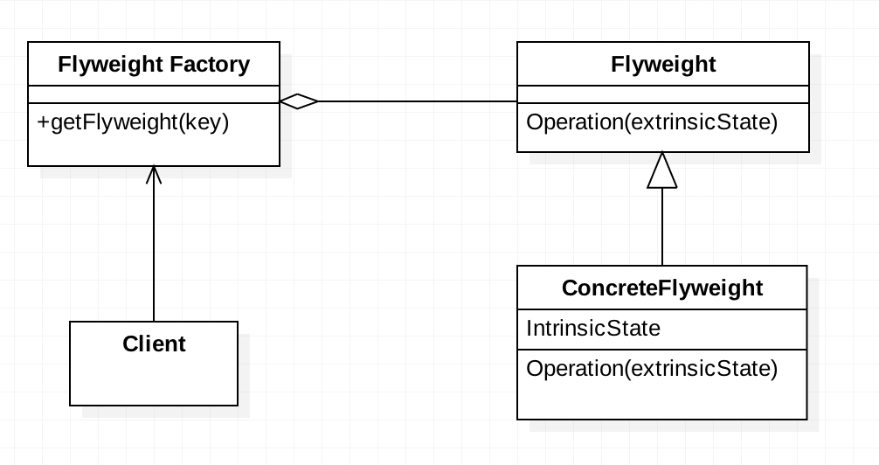
Class Diagram
What if I use flyweight pattern?
Shape
Color
Rectangular
Color
Size

Slide 6
If we create a flyweight factory…
public class RectFactory {
private static final Map<Color, Shape> rectsByColor = new HashMap<>();
public static Rect getRect(Color color) {
Rect rect = (Rect)rectsByColor.get(color);
if(rect == null) {
rect = new Rect(color);
rectsByColor.put(color, rect);
}
return rect;
}
}
Intrinsic state
Checks if a rectangle with a specific color has been made. If not it makes a new one, otherwise it returns one made already
Singletone design pattern

Slide 7
And change how we create instance…
public class Rect {
private Color color;
public Rect(Color color) {
this.color = color;
}
public void draw(Graphics g, int upperX, int upperY, int lowerX, int lowerY) {
g.setColor(color);
g.fillRect(upperX, upperY, lowerX, lowerY);
}
Test !
public static void main(String[] args){
Graphics g = drawingPanel.getGraphics();
for(int i=0; i < 100000; ++i) {
Rect rect = RectFactory.getRect(getRandColor()); rect.draw(g, getRandX(),getRandY(),getRandX(),getRandY()); }
}
Intrinsic state
Extrinsic state
Initialize rect by flyweight factory

Slide 8
Summary
Flyweight is reusing (obviously immutable) instances of a class wherever possible, rather than creating new instances of a class with the same "value", which saves CPU and memory.
For the sample code I made, it reduce the time from 4000ms to 2000ms
However, flyweight pattern introduces complexity and if number of shared objects are huge then there is a trade of between memory and time, so we need to use it judiciously based on our requirements.
Notes:
In our example, the client code is not forced to create object using Flyweight factory but we can force that to make sure client code uses flyweight pattern implementation but its a complete design decision for particular application.
Flyweight pattern introduces complexity and if number of shared objects are huge then there is a trade of between memory and time, so we need to use it judiciously based on our requirements.
Flyweight pattern implementation is not useful when the number of intrinsic properties of Object is huge, making implementation of Factory class complex.

Slide 9
Thank you

Slide 10
Reference
Book:
Design Patterns: Elements of Reusable Object-Oriented Software 1st Edition
Head First Design Patterns: A Brain-Friendly Guide 1st Edition
Internet Resource:
FLYWEIGHT DESIGN PATTERN TUTORIAL Posted by Derek Banas
Link: http://www.newthinktank.com/2012/10/flyweight-design-pattern-tutorial/

